Slide 1
REMOTE CONTROLLED AQUAWASTE COLLECTOR WITH LOT BASED WATER POLLUTION MONITERING AN TRACKING SYSTEM
By
SATHYA SHEELAN ,BOOPATHI RAJ ,MANISH ,VISHNUDATHAN

Slide 2
ABSTRACT:
Water pollution is increasing due to industrial sewage and waste dumping.
A Remote Controlled Aqua Waste Collector is proposed to monitor and clean polluted water.
The boat is equipped with sensors (pH, turbidity, temperature) to detect pollution levels.
Data is transmitted via IoT-based panel for real-time monitoring and alerts.
A GPS system helps locate pollution zones and optimize waste collection.
The system also includes a floating waste collection mechanism to remove debris from water bodies.

Slide 3
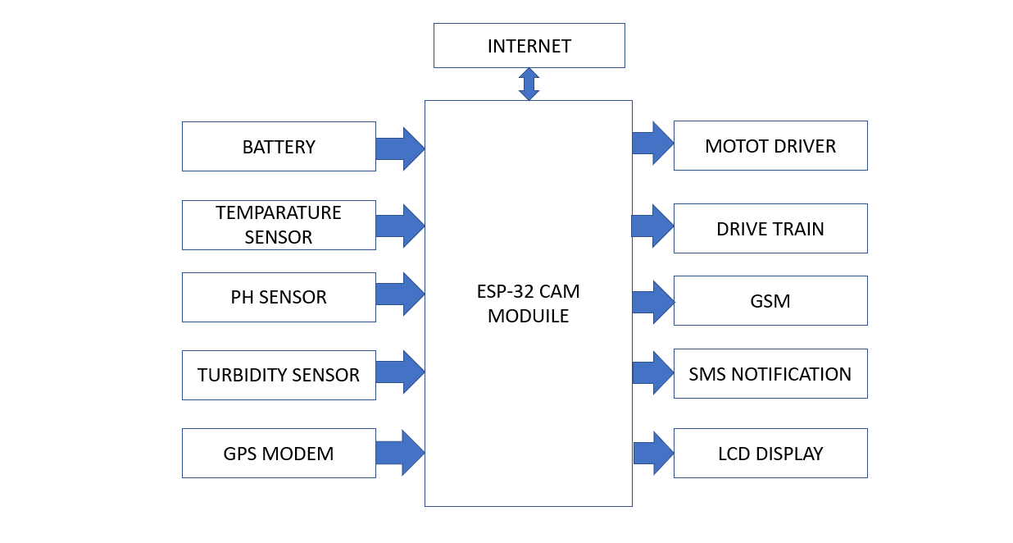
BLOCK DIAGRAM:

Slide 4
Key Components
ESP32-CAM: Captures images and streams video for remote surveillance.
Battery (Li-ion): Ensures long-lasting power for continuous operation.
Motor Driver: Controls boat movement and waste collection mechanism.
GSM Module: Enables remote alerts and communication.
LCD Display: Displays real-time sensor data.
Temperature Sensor: Monitors water temperature variations.
pH Sensor: Measures acidity & alkalinity, ensuring water safety.
Turbidity Sensor: Assesses water clarity, detecting pollution.
GPS Modem: Provides real-time location tracking of polluted areas.

Slide 5
Applications
Clean Waterways: Removes plastic waste, leaves, and floating debris.
Real-Time Pollution Monitoring: Detects pH, turbidity, and temperature changes.
Efficient Waste Management: GPS & IoT ensure precise data tracking.
Support for Aquatic Life: Reduces harm caused by toxic substances.
Public Health & Safety: Helps prevent waterborne diseases.
Research & Education: Provides data for pollution studies.

Slide 6
ADVANTAGES:
Real-Time Monitoring: Provides instant data on water quality, allowing for timely responses to pollution events.
Efficiency: Automates waste collection in water bodies, reducing the need for manual labor.
Accuracy: Enhanced precision in detecting and tracking pollution sources with the combination of sensors and GPS.
Cost-Effective: Reduces long-term operational costs by improving the efficiency of waste management and monitoring.
Environmental Impact: Helps maintain cleaner water bodies, supporting aquatic life and preventing the spread of waterborne diseases.

Slide 7
Thank you

